Slide 1
Mesh Topology
Md. Mohibullah Mohian
ID: 1204619
Batch:ID-NT/ACSL-01/R-28/01

Slide 2

What is Mesh Topology?
A mesh network is a network topology in which each node relays data for the network. All mesh nodes co-operate in the distribution of data in the network.

Slide 3
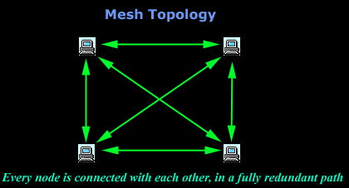
How to work?
Mesh networks can relay messages using either a flooding technique or a routing technique.

Slide 4
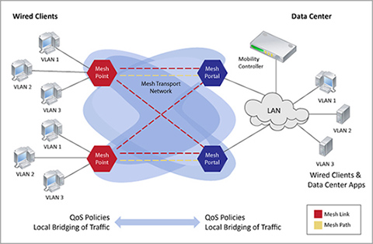
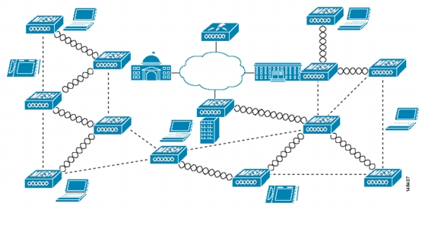
How to connect?
A mesh network whose nodes are all connected to each other is a fully connected network. Fully connected wired networks have the advantages of security and reliability.
Wired
wireless

Slide 5
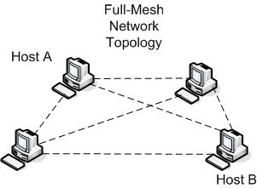
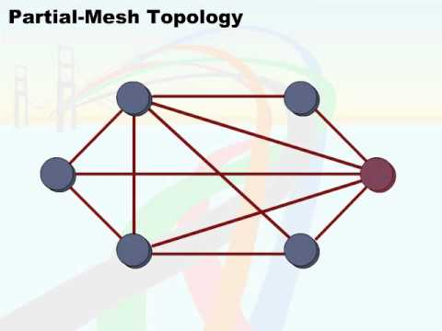
Types of Mesh topology..
1)Full Mesh Topology
2) Partial Mesh Topology

Slide 6
Advantage…
Data can be transmitted from different devices simultaneously.
Even if one of the components fails there is always an alternative present. So data transfer doesn’t get affected.
Expansion and modification in topology can be done without disrupting other nodes.

Slide 7
Dis-Advantage
There are high chances of redundancy in many of the network connections.
Overall cost of this network is way too high as compared to other network topologies.
Set-up and maintenance of this topology is very difficult.

Slide 8
END
Thank You

